Slide 2
BINARY NUMBERS multiplication
ICT 9 - Computer Systems Servicing

Slide 3


Slide 4
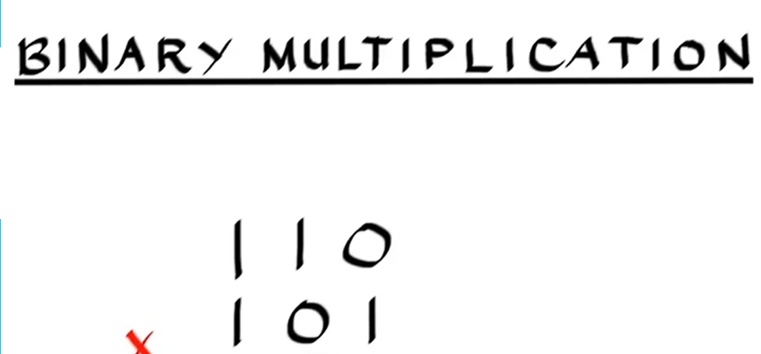

Slide 5
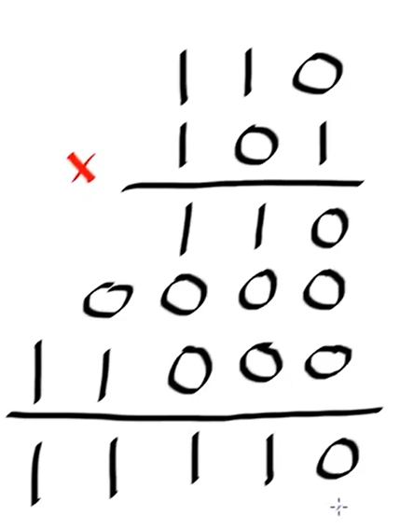
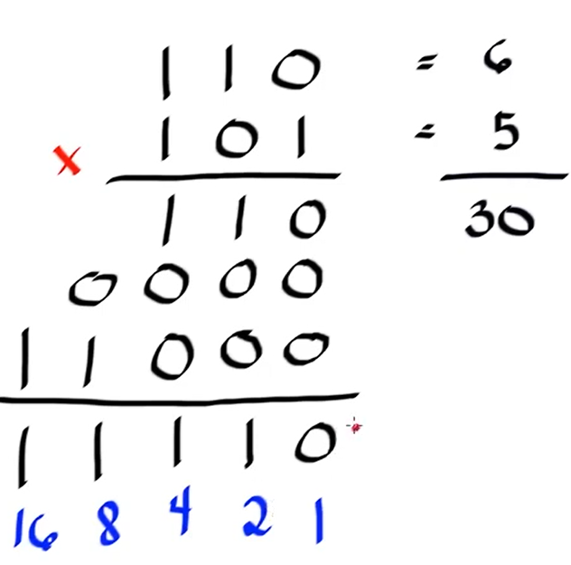

Slide 6
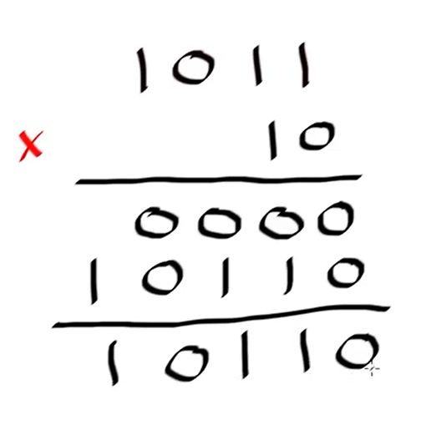
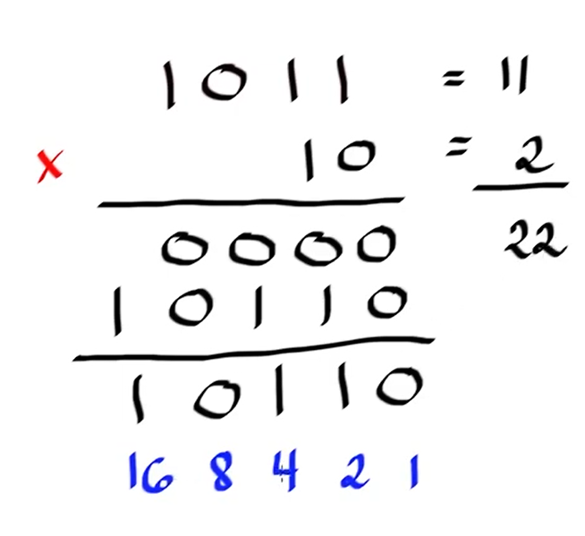

Slide 7
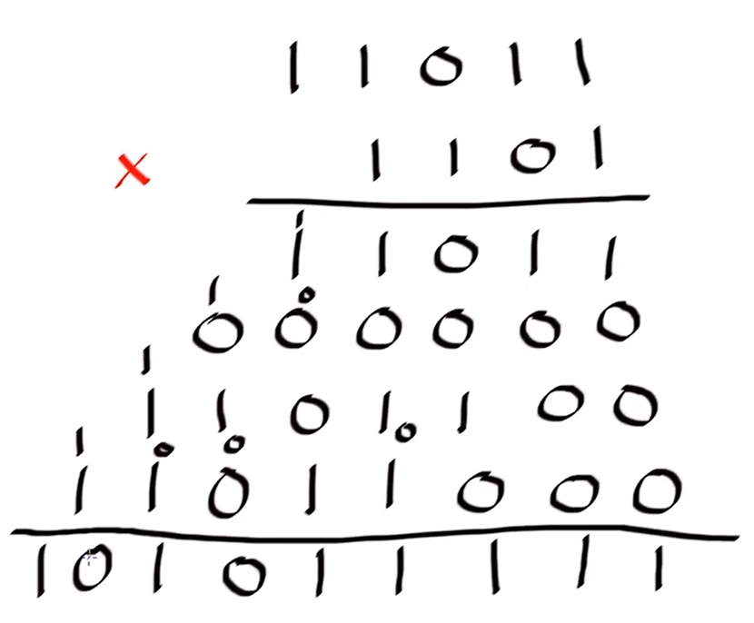

Slide 8
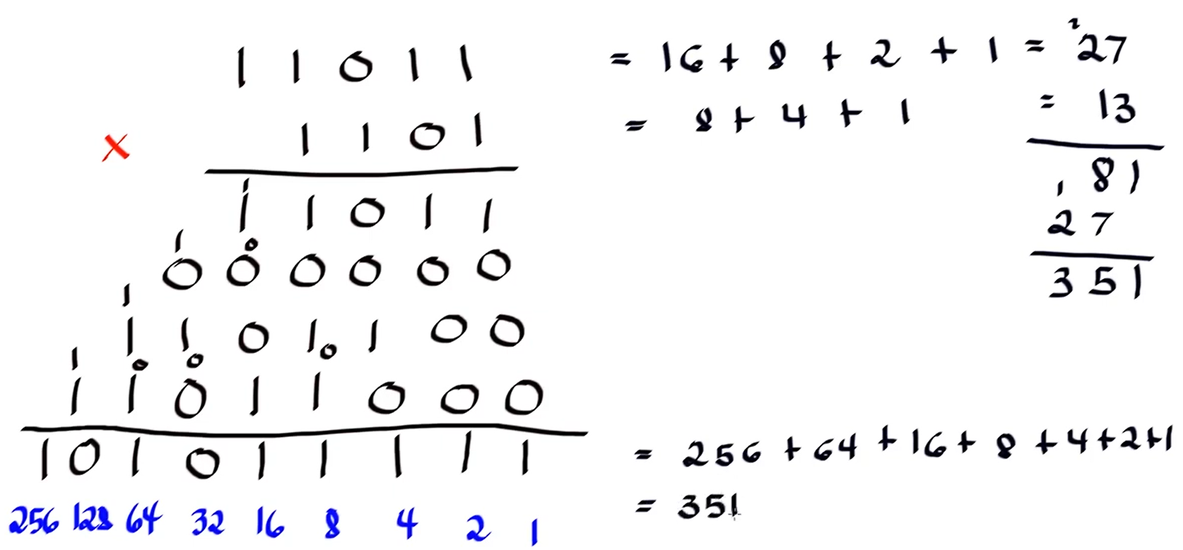

Slide 9
Multiply the binary numbers-
10 x 1=
11 x 10=
3. 110 x 11=
4. 1010 x 101=

Slide 10
Appetizer #11: Multiply the binary numbers-
10 x 11=
2.100 x 10=
3.101 + 11=
4.101 + 110=
5.1100 + 100=
6. 1110 + 101=

Slide 11
Thank You
for Learning
Teacher Mavic

